Slide 1
HPE Container Platform – Application Image development for Kubernetes Day 1
Course ID: HJ7H1S – 01129842
March 2020
Notes:
Hello All, in this session we will be learning about HPECP Application Image Development for Kubernetes.

Slide 2
Pre-requisites
Basic understanding of Docker
Basic understanding of Kubernetes
Basic understanding of HPE Container Platform

Slide 3
Agenda
Introduction to Kubernetes
Kubernetes Feature & Components
Deployments & Service
HPECP Kubernetes Application - Overview
Application Workflow, Labels & Service Endpoints
Development YAML Approach
KubeDirector Approach

Slide 4
Introduction to Kubernetes
Notes:
Lets start with a brief overview of Kubernetes

Slide 5
Introduction to Kubernetes
Kubernetes is a Container orchestration platform
It automates container deployment, scaling and management of containerized applications
Groups containers that make up an application
Supports
Batch execution
IPv4 and IPv6 addresses to pods and services
Tracking of network endpoints in a cluster
Managing multiple cluster at same time
Multiple infrastructure like, on premise, public cloud, or hybrid cloud
Resource isolation and utilization
Notes:
Kubernetes is a Container orchestration platform which automates container deployment, scaling and management of containerized applications.
It groups containers that make up an application
It supports:
Batch execution
IPv4 and IPv6 addresses to pods and services
Tracking of network endpoints in a cluster
Managing multiple cluster at same time
Multiple infrastructure like, on premise, public cloud, or hybrid cloud
Resource isolation and utilization

Slide 6
Kubernetes Features
Self-healing
Service discovery and load balancing
Horizontal scaling
Automated rollouts and rollbacks
Secret and configuration management
Storage orchestration
Notes:
Following are some features of Kubernetes
Self-healing – Kubernetes constantly checks the health of nodes and container. Restart containers if failed, replace and reschedules containers when node dies, kills containers if unhealthy
Storage orchestration – Automatically mounts and add storage system of user’s choice (local storage, public cloud, network storage or flocker) to run application
Service discovery and load balancing – Kubernetes assign pods their own IP address and single DNS name for a set of pods and load balance across them
Horizontal scaling – Easily and quickly scales your application up and down
Automated rollouts and rollbacks – Kubernetes progressively rolls out changes to your application, while monitoring application health. If somethings goes wrong, Kubernetes will rollback the change
Secret and configuration management – Allows to deploy and update secrets and application configuration without rebuilding your image and without exposing secretes

Slide 7
Kubernetes Components
When you deploy Kubernetes, you get a cluster
Kubernetes cluster consists of
Nodes – Runs containerized applications
Following are node components
kubelet
kube-proxy
Container runtime
Control Plane – Makes global decisions about cluster, detects and responds to cluster events
Following are control plane components
kube-api-server
etcd
kube-scheduler
kube-controller-manager
cloud-controller-manager
In production, control plane runs across multiple machines and cluster runs multiple nodes, for high availability and fault tolerance
Notes:
Following are Kubernetes cluster components:
Nodes – worker machines, that run containerized applications
Worker node host pods that are components of the application
Kubelet – An agent that runs on each node in the cluster. Ensures that containers are running in a pod
Kube-proxy – It is a network proxy which runs on each node in the cluster. Maintains network rules on nodes, which allows network communication to pods from network sessions inside or outside of the cluster
Container runtime – Responsible for running containers. Supported container runtimes are: Docker, containerd, CRI-O and Kubernetes CRI
Control Plane – manages worker nodes and the pods in the cluster
kube-api-server – It exposes Kubernetes API, which act as front end for Kubernetes control plane. It is designed to scale horizontally
etcd – Key value store used as Kubernetes backing store for all cluster data
kube-scheduler – Watch for newly created pods with no assigned nodes and assign a node for them
kube-controller-manager – It runs controller processes. Following are controllers:
Node controller – Notice and responds when any node goes down
Replication controller – Maintains the desired number of pods for every replication controller
Endpoints controller – Populates endpoints object
Service account & Token controllers – Creates default accounts and API access tokens for new namespaces
cloud-controller-manager – Runs controllers that interacts with underlying cloud providers

Slide 8

Kubernetes Cluster diagram
Kubernetes Control Plane
Cloud
kube-controller manager
cloud-controller manager
Kubernetes Nodes
kube-api-server
kubelet
kubelet
kubelet
Kube-proxy
Kube-proxy
Kube-proxy
etcd
kube-scheduler
Notes:
The above diagram depicts Kubernetes cluster diagram.

Slide 9
Kubernetes – Deployment
Sample YAML file for Nginx deployment – deployment.yaml
Deployment provides declarative updates for Pods and ReplicaSets
Deployment is used for
Creating a new ReplicaSets
Remove existing deployments
Rollback
Upgrades
Scaling
Pause & Resume change
apiVersion: apps/v1
kind: Deployment
metadata:
name: nginx-deployment
labels:
app: nginx
spec:
replicas: 3
selector:
matchLabels:
app: nginx
template:
metadata:
labels:
app: nginx
spec:
containers:
- name: nginx
image: nginx:1.7.9
ports:
- containerPort: 80
Notes:
Kubernetes Deployment provides declarative updates for Pods and ReplicaSets
Deployment is used for
Creating a new ReplicaSets
Remove existing deployments
Rollback
Upgrades
Scaling
Pause & Resume change

Slide 10
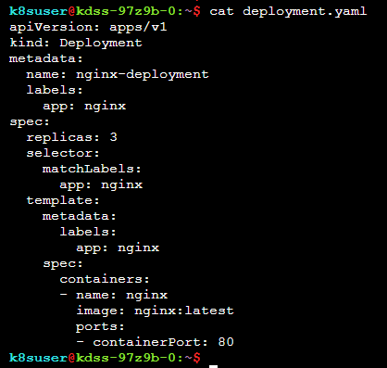
Deployment file
YAML file parameters are:
apiVersion – shows the K8 API version
kind – represents the type of K8 object
metadata – data which helps to identify the K8 object
spec – represents the desired state for the K8 object
Deployment name – nginx-deployment
This deployment is created 3 pod replicas, specified in replicas
Selector is defines which pods to manage
Template defines what is the pod definition

Slide 11
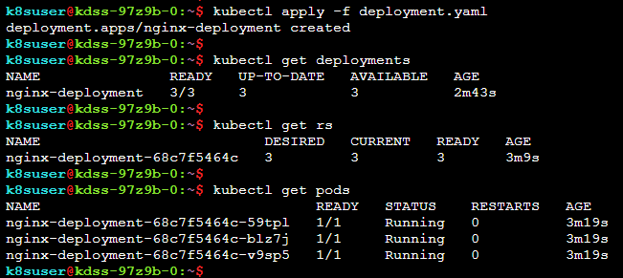
Deployment – Commands
To deploy deployment using the deployment yaml file
kubectl apply –f <deployment_file>.yaml
To get a list of deployment
kubectl get deployments
To view ReplicaSet created by the deployment
kubectl get rs
To view a list of pods
kubectl get pods

Slide 12
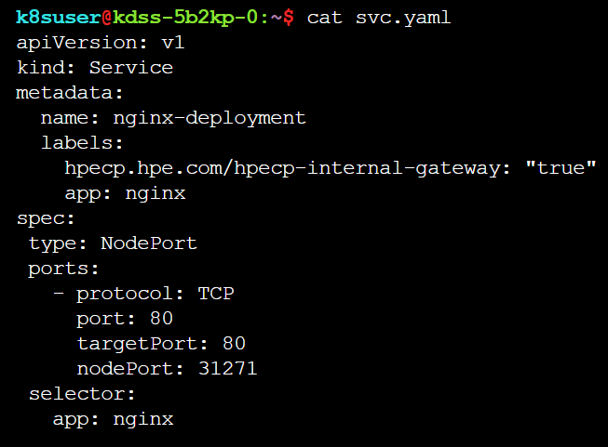
Kubernetes – Services
Service is used to expose an application running on a set of pods as network service
It defines a logical set of pods and a policy to access them
It is a REST object
Service File:
Service name – nginx-deployment
Ports describes the ports used by the service
Pods are listening on port 80
Selector specifies the set of pods targeted by the service
Type : NodePort exposes service on each node’s IP at a static port
This YAML file creates a nginx-deployment service object, which targets port 80 on any pod with the label nginx
Sample YAML file for Nginx service – svc.yaml
Notes:
Kubernetes assign IP address and a single DNS name to the pods

Slide 13

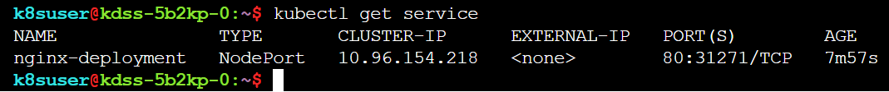
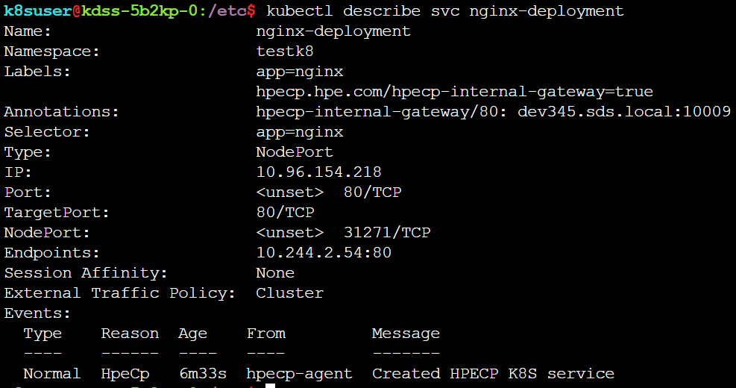
Service – Commands
To deploy service using the service yaml file
kubectl apply –f <service_file>.yaml
To get a list of services
kubectl get services
To get information of any service
kubectl describe service <Service_name>

Slide 14
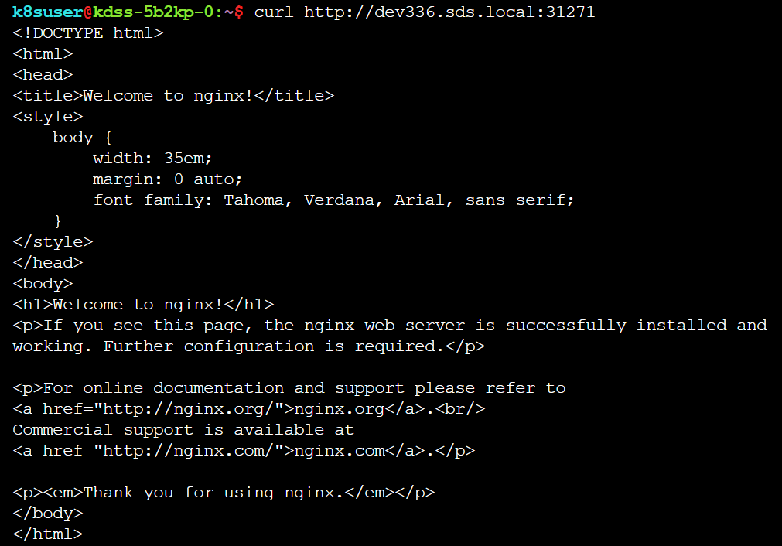
Service – Commands (Cont…)
Access the service using the node’s IP and port (from the service describe command)

Slide 15
HPECP – Kubernetes Application Development

Slide 16
Kubernetes Application Overview

Slide 17
Application Overview
Kubernetes pods can be launched using Kubernetes Application
Kubernetes Application has
KubeDirector – Allows to launch pods
Kubectl – Allows to onboard Kubectl application
Applications are deployed via
Deployment YAML approach via web terminal
KubeDirector approach
Converting EPIC standard image to KubeDirector Image
Helm Chart

Slide 18
Application workflow
For Kubernetes Application (KubeDirector) deployed via Web Terminal
Create Dockerfile
Build Docker Image
Push Image to Docker Hub
Clone KubeDirector project using git
Create JSON file
Execute JSON file via Kubectl command
Launch application from Kubernetes Applications screen

Slide 19
Application workflow
For Application that is converted from HPECP Classic Application to KubeDirector App
Create Dockerfile
Build Docker Image
Push Image to Docker Hub
Obtain appconfig.tgz
Create JSON & YAML file
Clone KubeDirector project using git
Execute JSON file
Launch application from Kubernetes Applications screen

Slide 20
Application workflow
For Application that is deployed using kubectl (FS Mount)
Create Dockerfile
Build Docker Image
Push Image to Docker Hub
Create YAML files
Upload YAML files
Apply YAML files

Slide 21
Application workflow
For Kubernetes Application deployed using Helm
Create Dockerfile
Build Docker Image
Push Image to Docker Hub
Create Helm charts and template
Install Helm chart

Slide 22
Labels to support HPECP features
Label | Description | Format
hpecp.hpe.com/fsmount | Pod label to trigger FS Mount | hpecp.hpe.com/fsmount: <FS_Mount_namespace>
hpecp.hpe.com/dtap | Pod label to trigger DataTap | hpecp.hpe.com/dtap: inject
hpecp.hpe.com/hpecp-internal-gateway | Service label used to control gateway mapping (NodePort only) | hpecp.hpe.com/hpecp-internal-gateway: <"true"/"false">
hpecp.hpe.com/portname-override | Service label used to force port name (single-port service only) | hpecp.hpe.com/portname-override:<port_name>

Slide 23
FS Mount Label
Attaches a persistent volume to the container. If this is not defined, then default PV will be used
apiVersion: v1 kind: PersistentVolumeClaim metadata: name: pvc-sample spec: accessModes: - ReadWriteOnce resources: requests: storage: 2Gi
--- apiVersion: v1 kind: Pod metadata: name: pod3 labels: layers: single sample: httpd3 hpecp.hpe.com/fsmount: k8s spec: containers: - name: c1 image: bluedata/centos7 ports: - containerPort: 80 volumeMounts: - name: pvcloc mountPath: /mnt volumes: - name: pvcloc persistentVolumeClaim: claimName: pvc-sample
This is exclusively for HPECP K8s cluster to mount the label to default FS Mount on pod

Slide 24
DataTap Label
apiVersion: v1 kind: Pod metadata: name: demo namespace: k8s labels: hpecp.hpe.com/dtap: inject spec: containers: - name: app image: docker.io/xoxoxoxoxoxo/app:1.0 resources: limits: cpu: "300m" memory: "300Mi" requests: cpu: "300m" memory: "300Mi" lifecycle: postStart: exec: command: ["/bin/sh", "-c", "mkdir -p /opt/bdfs; cp -f /opt/dtap/hadoop-core-2.6.0-BlueData.jar /opt/bdfs/bluedata-dtap.jar; cp -f /opt/dtap/libjni_memq_cnode.so /opt/bdfs/libjni_memq_cnode.so"]
This will enable accessing data through dtap

Slide 25
Gateway Mapping Label
apiVersion: v1
kind: Service
metadata:
name: hello-world-service-epic-lb
labels:
hpecp.hpe.com/hpecp-internal-gateway: "true“
hpecp.hpe.com/portname-override: 'http-9000'
spec:
selector:
app: nginx
ports:
- name: http-hello
protocol: TCP
port: 80
targetPort: 80
type: NodePort
This label causes HPECP to generate a service port on the Gateway host

Slide 26
Port Name Override
apiVersion: v1
kind: Service
metadata:
name: hello-world-service-epic-lb
labels:
hpecp.hpe.com/hpecp-internal-gateway: "true“
hpecp.hpe.com/portname-override: 'http-9000'
spec:
selector:
app: nginx
ports:
- name: http-hello
protocol: TCP
port: 80
targetPort: 80
type: NodePort
Only endpoints with such port name prefixes will get clickable links in the Kubernetes Service Endpoint screen

Slide 27
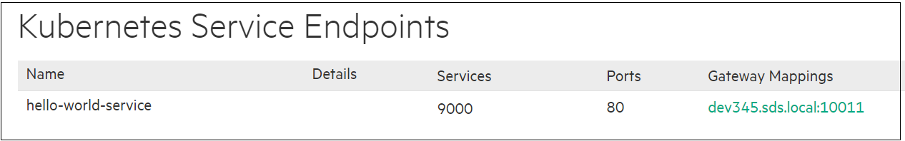
Example for Gateway Mapping and Port name override label
apiVersion: v1
kind: Service
metadata:
name: hello-world-service-epic-lb
labels:
hpecp.hpe.com/hpecp-internal-gateway: "true“
hpecp.hpe.com/portname-override: 'http-9000'
spec:
selector:
app: nginx
ports:
- name: http-hello
protocol: TCP
port: 80
targetPort: 80
type: NodePort

Slide 28
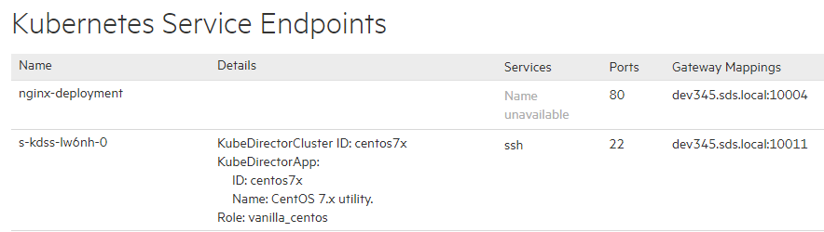
Service Endpoints
Allows to view and access services running on Kubernetes containers
Following information is displayed for each virtual node/container in Kubernetes cluster
Name – Name of virtual node/container
Details – Information about the virtual node/container
Services – List of services running on virtual node/container
Ports – Host port for the service
Gateway Mappings – Gateway hostname and port to which service is mapped

Slide 29
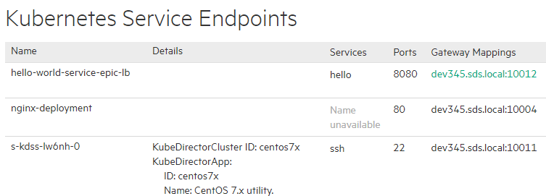

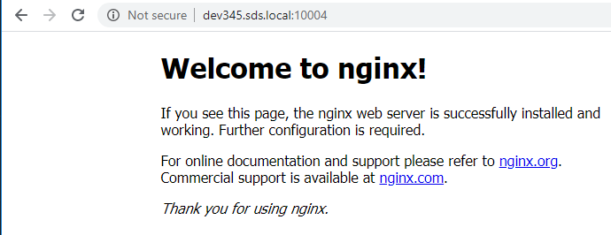
Access Service Endpoints
Clicking (or navigating) the Gateway Mappings opens service in a new tab

Slide 30
Developing & Deploying applications
Methods of Deploying Applications
Approaches of Developing Applications

Slide 31
METHODS OF DEPLOYING APPLICATIONS
Following are the methods to deploy applications
Kubeconfig
Webterminal
Kubectl (FSMOUNT)

Slide 32
Approaches of developing application
Following are the approaches of developing application (Using web terminal)
Developing application using the KubeDirector approach
Converting EPIC classic application to KubeDirector application
Developing application using Helm charts

Slide 33
Deployment YAML approach
Following are the steps in Deployment YAML approach using Kubernetes Web Terminal
Create Deployment YAML file
Apply Deployment YAML file to create deployment
Create Service YAML file
Apply Service YAML file to create service
Access the application

Slide 34
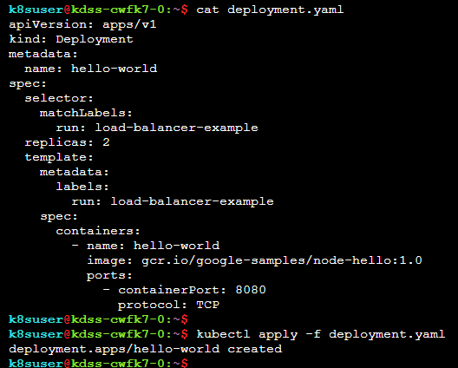
Deployment YAML Approach Example
Deployment YAML file
Applying the Deployment YAML file to create the deployment
Notes:
Creating and applying the Deployment file

Slide 35
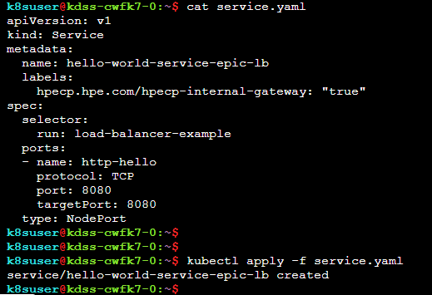
Service YAML Approach Example
Service YAML file
Applying the Service YAML file to create the service
Notes:
Creating and applying the Service file

Slide 36
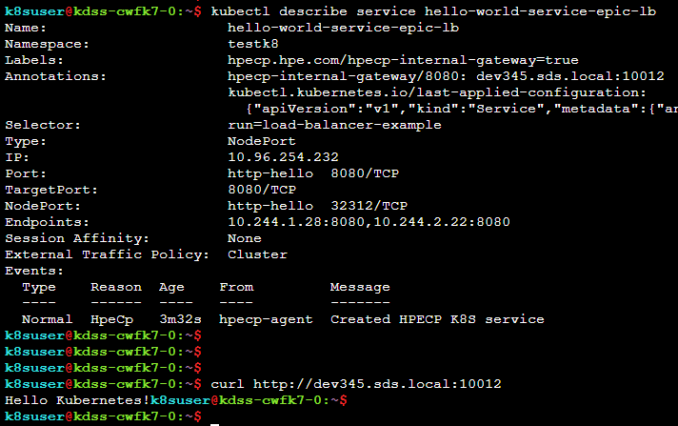

Service YAML Approach Example
Shows the Gateway hostname or IP and port to which the service is mapped
Accessing the Hello-World application using the Gateway host and port
Notes:
Accessing the service

Slide 37
Lab #1 Initial Login
Task 1: Initial Login

Slide 38
Lab #2 Deploy “hello world” Kubernetes application via web terminal
Task 1: Deploy Application in HPE Container Platform
Task 2: Accessing Application

Slide 39
Lab #3 Deploy “Springboot” Kubernetes application via web terminal
Task 1: Create Dockerfile
Task 2: Build the Docker image
Task 3: Push Docker image to Docker hub
Task 4: Deploy Application in HPE Container Platform

Slide 40
KubeDirector

Slide 41
KubeDirector overview
KubeDirector is a Kubernetes “custom controller”
It simplifies the packaging, deployment, and management of complex distributed stateful applications for BigData and AI usecases
Creates/modifies standard K8s resources (StatefulSets etc.), to implement specs from CRs
Differs from normal Kubernetes Operator pattern:
No app-specific logic in KubeDirector code
App deployment is data-driven from external app definitions
Supports interactions among different apps + other objects
Analyze
Observe
Act

Slide 42
KubeDirector Concepts: Custom resource definitions
Primary CRD: KubeDirectorCluster
Models any kind of application instance launchable by KubeDirector
Other CRDs for related objects, like:
App definitions (KubeDirectorApp)
DataTaps and other shared storage
Config sets for AD/LDAP integration for containers
Machine Learning models

Slide 43
KubeDirector concepts
KubeDirector
Application Creation Request
Application Type Definition
Resource Platform (Kubernetes)
Deploy App Cluster
App role X members
Container Image Repository
App role Y members
Application Configuration Artifacts

Slide 44
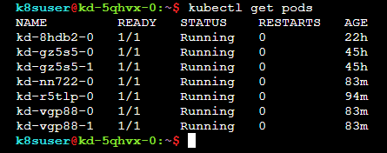
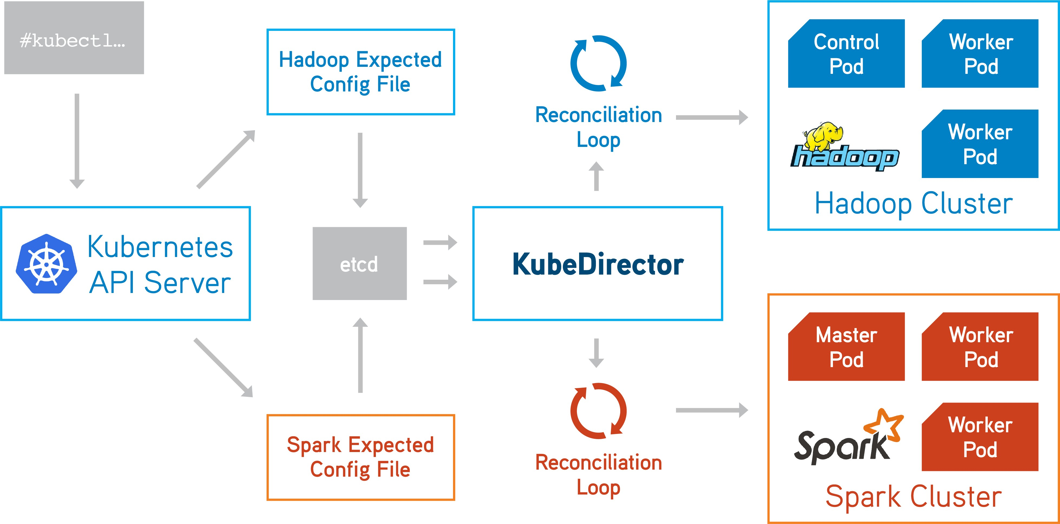

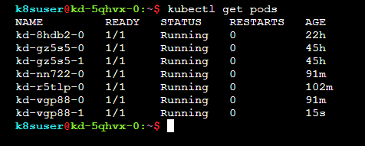
Deploy application with KubeDirector
Below is the status of before deleting the pod
kubectl create -f kubedirector/h2o.yaml
Deleting pod
Below is the status of after deleted the pod
Notes:
Reconciliation: When you first create a Deployment, there is no Pod running, because this is the first time you are creating it. So K8s will start the required Pod immediately. If the Pod was ever to stop, Kubernetes(K8s) will start it again, as long as the Deployment exists.
With creating Deployment, K8d controllers know that the Pod must always be running. Hence, even if we delete the Pod ourselves, Kubernetes assumes we must probably made a mistake, and starts a new Pod to replace the deleted one.
Reconciliation loop is part of K8s self healing abilities. When something goes wrong, meaning the desired state and the actual state doesn't match, K8s will try to close the gap, forever.

Slide 45
KubeDirector Approach
Creates application using KubeDirector operator
Pre-requisite
JSON or YAML file with all metadata information
If JSON is present, platform auto-generates YAML file

Slide 46
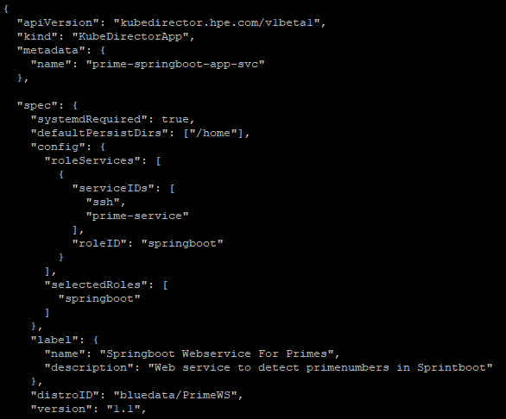
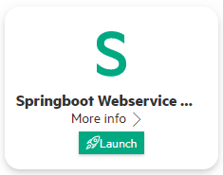
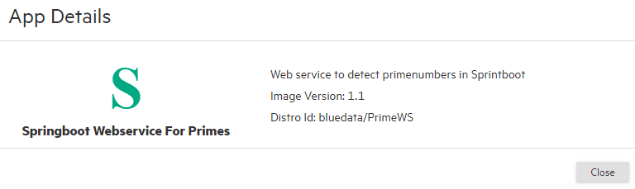
JSON File
Deploying .json file add the application to Kubernetes Application page

Slide 47
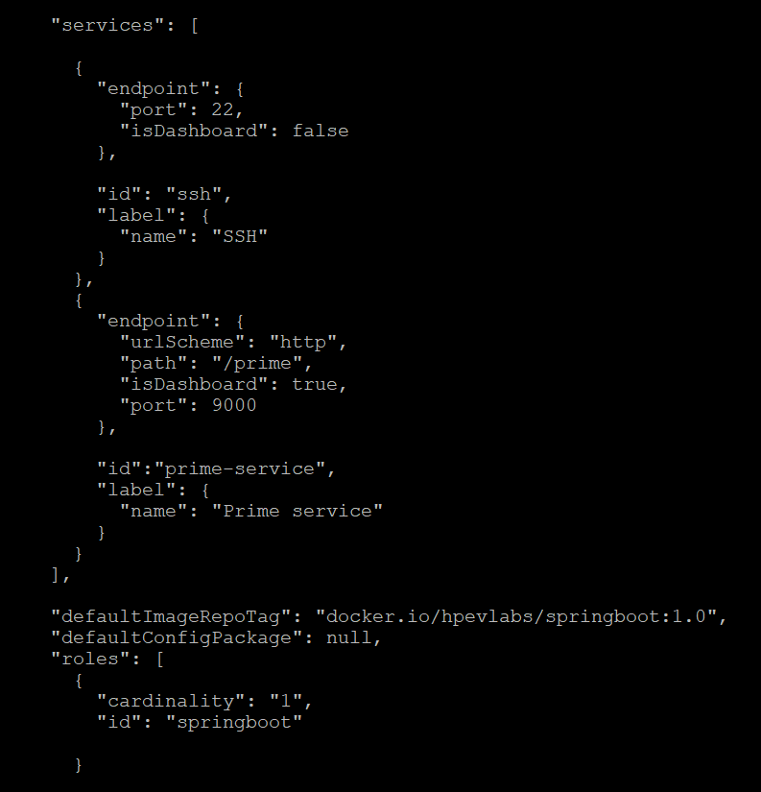
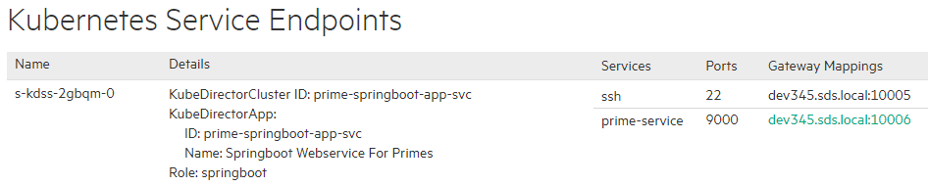
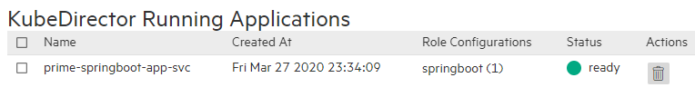
JSON File
Pulls the image from Docker Hub

Slide 48
Lab #4 Deploy “Springboot” Kubernetes application (KubeDirector) via web terminal
Task 1: Create & apply JSON file
Task 2: Launch application from Kubernetes Application page

Slide 49

Q&A

Slide 50
THANK YOU

